Slide 1
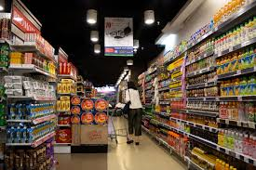
Superstore Sales Analysis Using SQL By Harsh Tailor

Slide 2
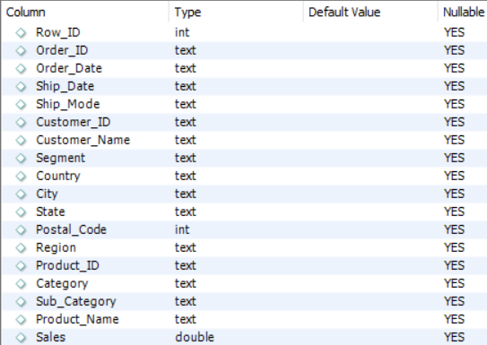
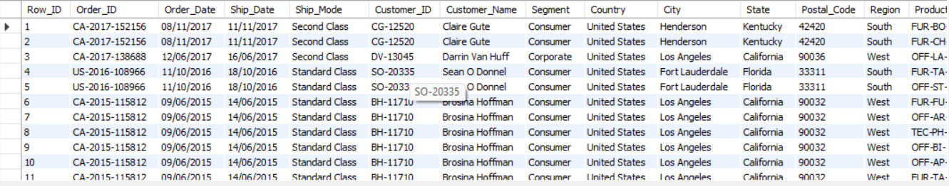
Dataset Used for Analysis
Columns
Sample Values

Slide 3
Key Factors for Analysis
same day shipping percentage
top 4 items with highest average sales per day
average order value of customer and rank them Accordingly
most demanded sub-category in east region
order with highest number of items
order with highest cumulative value
Priority for First Class Shipment with respect to segment
city with least revenue
top 3 city with most revenue

Slide 4
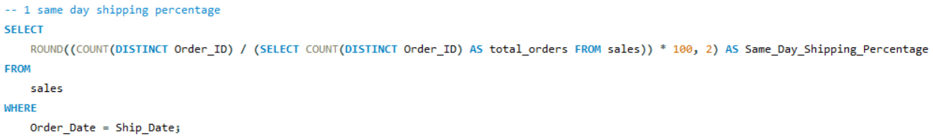
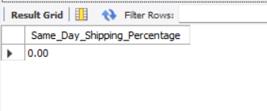
Q1) same day shipping percentage

Slide 5
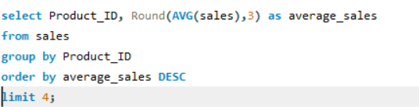
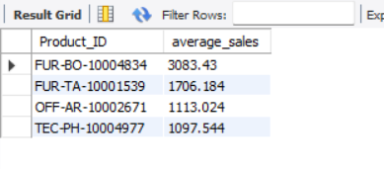
Q2) Top 4 items with highest average sales per day

Slide 6
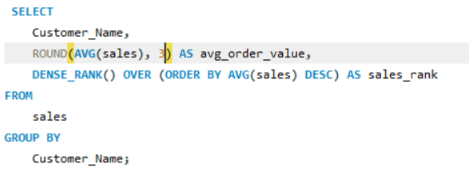
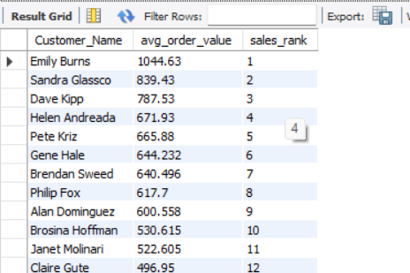
Q3) Average order value of customer and rank them Accordingly

Slide 7
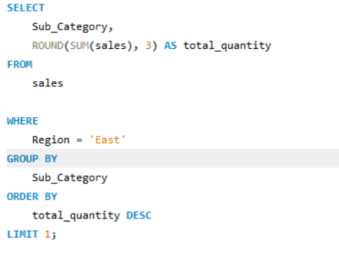
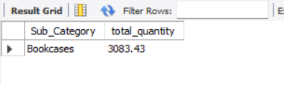
Q4) Most demanded sub-category in “east” region

Slide 8
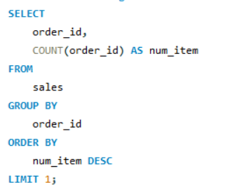

Q5) Order with highest number of items

Slide 9
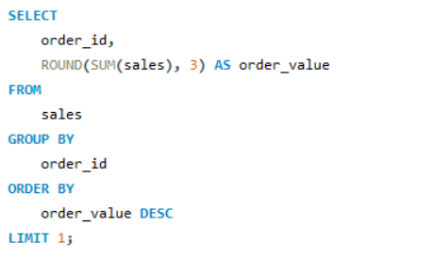
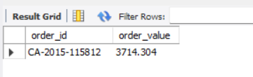
Q6) Order with highest cumulative value

Slide 10
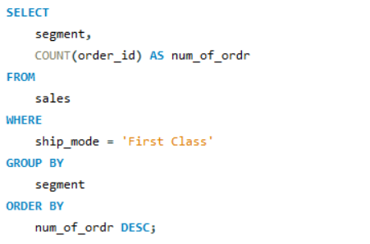
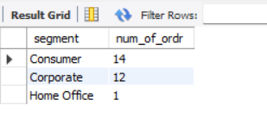
Q7) Priority for First Class Shipment with respect to segment

Slide 11
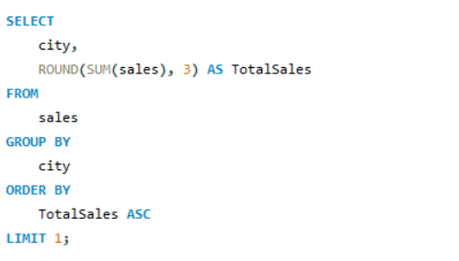
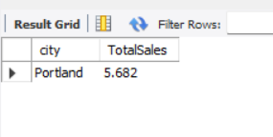
Q8) City with least revenue

Slide 12
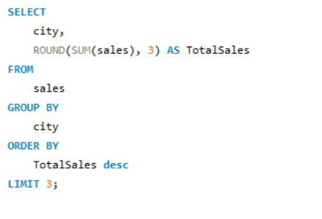
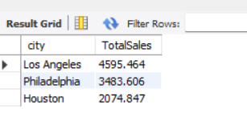
Q9) Top 3 city with most revenue

